Slide 1
Evaluating the Reliability of Deep Learning-Based Models for Lung Cancer Risk Prediction: The Impact of Input Variations
Gary Ge, PhD, Jie Zhang, PhD

Slide 2
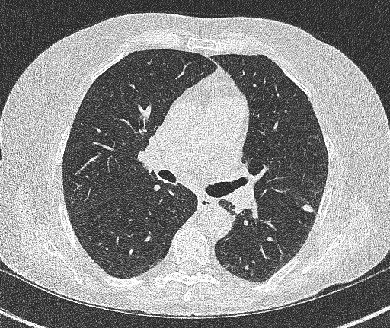
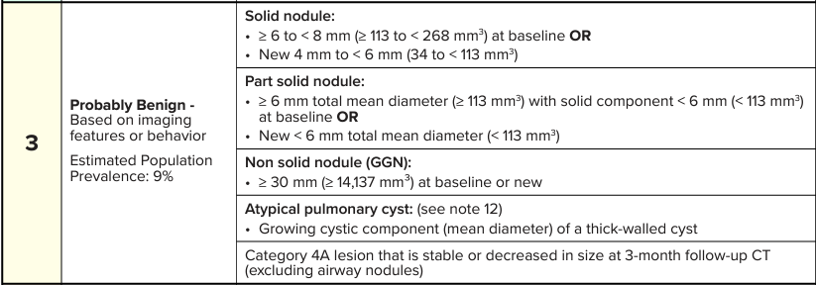
Lung Cancer Screening
Early detection of lung nodules in at-risk population
Screened using Low-Dose CT (LDCT)
Standardized protocols
Performed at regular intervals
Lung-RADS
Metrics used for assessment
Size / growth
Morphology
Location
Identifying cancer risk is a challenge
Small ≠ benign
Can clinical decision-making be improved?

Slide 3
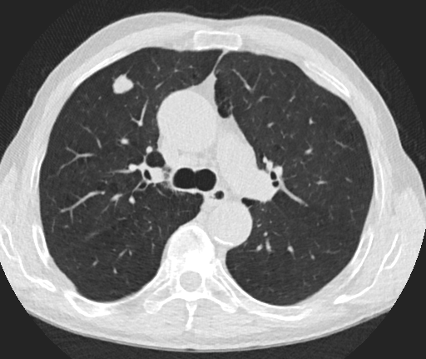
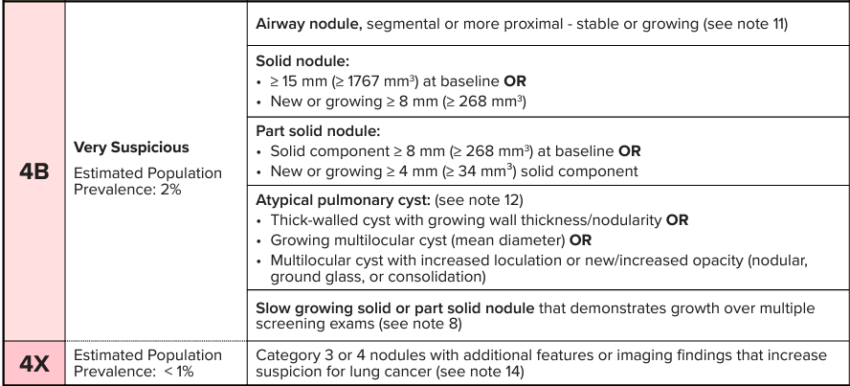
Lung Cancer Screening
Early detection of lung nodules in at-risk population
Screened using Low-Dose CT (LDCT)
Standardized protocols
Performed at regular intervals
Lung-RADS
Metrics used for assessment
Size / growth
Morphology
Location
Identifying cancer risk is a challenge
Small ≠ benign
Can clinical decision-making be improved?

Slide 4
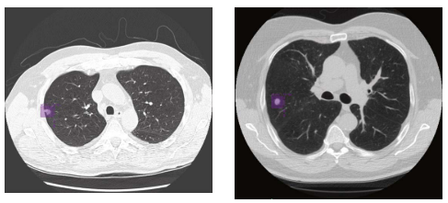
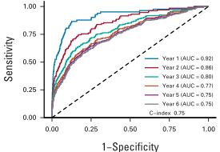
Sybil: Lung Cancer Risk Prediction Model
Predicts future lung cancer risk out to 6 years from single LDCT
Assigns “risk score” from 0 – 1
Likelihood of lung cancer diagnosis
Example output for one patient
YR 1 – 0.05, YR 2 – 0.06 … YR 6 – 0.075,
Deep-learning model design
Uses lots of data
Training – 15000 patients
Independent testing – ~26000 patients
Achieved strong results
Examples of automatic lesion detection performed by Sybil
Sybil achieved AUC of 0.92 – 0.76 for lung cancer risk out to 6 years

Slide 5
Impact of Input Variations
Prior work show radiomic models are impacted by CT acquisition parameters
Reconstruction kernel, slice thickness
What about deep-learning models?
Different reconstruction kernels - B31f (top) and B60f (bottom)

Slide 6
Methods
Study Cohort
Smooth
Kernel
Sharp
Kernel
Retrospective study
157 LDCT acquisitions
All positive for lung nodules
Percent difference of lung cancer risk based on varying acquisition parameters
Reconstruction kernel
Slice thickness
SYBIL
SYBIL
Risk Prediction 1
Risk Prediction 2
% DIFF
Study workflow to evaluate reconstruction kernels.

Slide 7
Main Results
Slice
Thickness
Kernel
Selection
Reconstruction kernel: Smooth vs Sharp
31.5%±24% (0-92%)
Slice Thickness
Same slice thickness/Different kernel
19.4%±19.8% (0-64%)
Different slice thickness/Different kernel
32.2%±24.1% (0-92%)
Each input parameter contributes uncertainty
Model Uncertainty
Other
Parameters?

Slide 8
Conclusion & discussion
Input variations affect deep learning model output
Effect on visual and quantitative aspects of images can be large
CT acquisition parameters are routine clinical practice
Lung cancer risk prediction values
Impact of inputs are not small: 31.5%±24% (0-92%)
Potentially impact clinical decisions
Sybil is well-trained and designed correctly
Simple changes result in >30% variance in output
What about other models?

Slide 9
Future Work
Further investigate inter- and intra-scanner variations
GE vs Siemens vs Philips etc.
Siemens Force vs Edge
How to improve model performance?
Larger datasets
Image harmonization
Harmonization

Slide 10
Questions?

