Slide 1

Mythbusters Demystifying the 3rd year Student
Sam Linton
Lindsay Williams
University of Kentucky College of Medicine

Slide 2
Disclosure
We do not have any relevant financial relationships with any commercial interest that pertains to the content of our presentations.

Slide 3
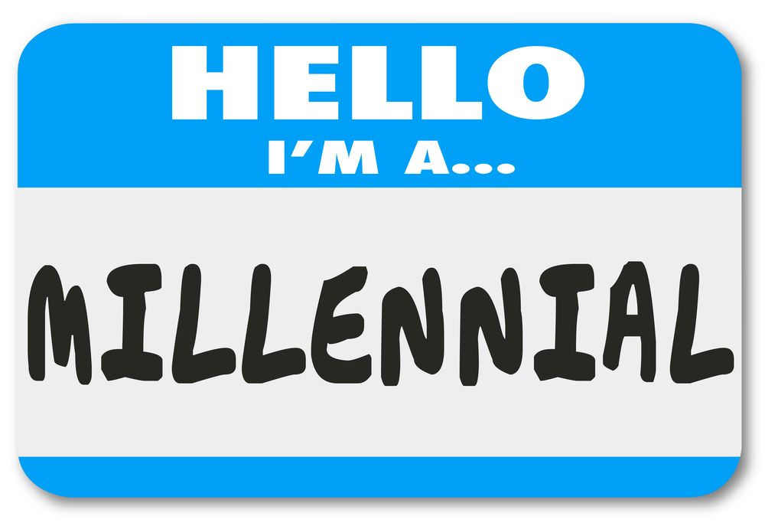
Overview
Stereotypes from both sides
Expectations from both sides
The survey questions
Examples
Consensus
Discussion
Conclusion
Notes:
L

Slide 4
What you say about us….
Spoon fed
Instant feedback
No negative feedback
Shift-work mentality
“Work-life balance”
Rule followers
Tech-savvy
Notes:
S
-Everyone gets a trophy
- lazy
Some of the things that Dr. Iocono brought up are that our generation needs to be spoon fed and demands to know how we are doing, but can’t handle criticism. We are perceived to expect clearly scheduled shifts with time for a life outside of medicine, which is often seen as laziness by older generations.
We are also seen as dependent on rules and guidelines with little ability to make our own plan.
Fortunately we have one recognizeable upside in that we easily navigate technology

Slide 5
What we say about you…
Unrealistic expectations
Poorly defined expectations
Unable to relate to our level of training
Assume that the younger generations are ‘inferior’ or ‘lazy’
Insensitive to the demands on a medical student in the 21st century
Notes:
L

Slide 6
What you want
Communication skills
Information synthesis
Professionalism
Work ethic
Accurate H&Ps
Enthusiasm
Taking advantage of learning opportunities
High shelf scores
Notes:
S
http://www.ncbi.nlm.nih.gov/pubmed/27481094
“Defining honors in the surgery clerkship”
A recent study polling med school clerkship directors and residency program directors showed that what you really want is an enthusiastic, hard working student with good communication skill and an ability to take accurate H&Ps and synthesize all the information thrown at us and learn from it. And at the end of a month doing this every day, get good shelf scores.

Slide 7
What we wish you remembered
You were once a 3rd year medical student who knew nothing.
The OR is like nothing most of us have ever experienced before; the first 2 years of medical school prepare us for medicine wards and clinic, not surgery.
Feeling useless is terrible, you just want to feel like you are contributing.
Notes:
L
Should reference studies

Slide 8
Questions from the Survey:
Best experience on Surgery?
The last day.
Notes:
L “so lets jump right in”

Slide 9
The Questions Asked:
What was your best experience on your surgery clerkship? How did the rest of your team contribute to that experience? What did you learn from it?
What was your worst experience on your surgery clerkship? How did your team contribute to that experience? What do you wish had gone differently?
What characteristics did your favorite/least favorite resident/attending possess?
What do you wish your educators (residents/ attendings/etc) remembered about medical school?
Notes:
L

Slide 10
Question 1
What was your best experience on your surgery clerkship? How did your team contribute to that experience?
Notes:
L

Slide 11
Responsive to investment
What was your best experience on your surgery clerkship? How did your team contribute to that experience?
"There were several major surgeries that I really enjoyed seeing and learning from. Residents and attending did a good job explaining what was being done and keeping me engaged. ie, the opportunity to guide the camera during a laparoscopic case made me feel that I was making an important contribution to the surgery, but also kept me invested in what was going on. It provided me valuable experience orienting myself to relevant anatomy and learning how to drive the camera.”
Notes:
L

Slide 12
Responsive to instruction
What was your best experience on your surgery clerkship? How did your team contribute to that experience?
“We live for our feedback. We want to know what we are doing well and what we need to work on. But being ignored will serve no purpose”
Notes:
L

Slide 13
Responsive to engagement
What was your best experience on your surgery clerkship? How did your team contribute to that experience?
“The residents were eager to teach me and to involve me in whatever was going on. I felt like a real member of the team. I knew what was expected from me from the get-go, and that made me more motivated and more confident. The attendings were great at teaching as well. I knew to be prepared for the OR, to know about the procedure and about the patient, and the residents were great about helping me out with what to expect.”
“I enjoyed being around smart, motivated people that enjoyed what they were doing, and were willing to teach.”
Notes:
L

Slide 14
The Consensus: Question 1
Feeling included, like part of the team
Continuity with a resident that spent time teaching and getting the student involved
Having tasks delegated to them
Cool surgeries and procedures
Notes:
L

Slide 15
Question 2
What was your worst experience on your surgery clerkship? How did your team contribute to that experience?
Notes:
S

Slide 16
Feeling excluded
What was your worst experience on your surgery clerkship? How did your team contribute to that experience?
“Not being involved in procedures even in limited capacities, I wish I could have been able to do more.”
“Feeling so obsolete. We already feel like we are mostly in the way. So it is a treat when we feel like we are actually able to do a task that contributes to the team and not actually creating more work for someone”
Notes:
S
One of the themes that our classmates hit on repeatedly in the surveys was that they wished they could do more to contribute to the team.

Slide 17
Poor instruction, lack of feedback
What was your worst experience on your surgery clerkship? How did your team contribute to that experience?
“When my attending got frustrated during a surgery and yelled at me for no reason. He expected me to be helping but I had no idea how to help. I wish he had asked me specific things to do which of course I would have done, instead of just yelling.”
“Attempting to learn new skills in the OR with those that physically show impatience and attempt to make passive aggressive/derogatory comments. Unfortunately, this type of environment is really discouraging toward pursuing a career in surgery.”
Notes:
S
They felt like part of not contributing to the team was that no one told them what to do.
Additionally, they were often discouraged by the impatience of surgeons and derogatory comments made toward their struggle lto learn in the OR.

Slide 18
The Consensus
What was your worst experience on your surgery clerkship? How did your team contribute to that experience?
Being talked down to or ignored
Abusive environment
Being entrusted with only menial tasks
Feeling that their time was wasted
Notes:
S
Most student’s worst experience involved be yelled at or demeaned, while individuals overall negative feedback for the clerkship was that they felt like they were not able to contribute in a meaningful way to the team.

Slide 19
Question 3
What characteristics did your favorite resident/attending possess?
Notes:
L

Slide 20
Took ‘ownership’ of students
What characteristics did your favorite resident/attending possess?
“Kindness, frequent helpful feedback, positive reinforcement.”
“Humility. The attending and residents that were best at teaching were the ones that stressed status the least, did not refer to me as "the med student" and actually learned my name.”
“My favorite residents were able to perceive my interest and took me in as a mentee almost. They taught and gave me feedback because I demonstrated a willingness to learn.”
Notes:
L

Slide 21
The Consensus
What characteristics did your favorite resident/attending possess?
Being patient
Being approachable and humble
Took opportunities to teach
Inclusive; got the students involved
Notes:
L
Went out of their way

Slide 22
Question 4
What characteristics did your least favorite resident/attending possess?
Notes:
S

Slide 23
Impatient, arrogant
What characteristics did your least favorite resident/attending possess?
“Short tempered, demanding, pompous, arrogant, impatient.”
“Those that were rude and did not include us in patient care. I would have considered surgery as a potential career path much more strongly if less residents/attendings made life hard for both students and eachother as if it is some rite of passage to be harassed. I do not mind to be at the hospital long hours, but if so I want to be involved in patient care, not ignored.”
“Poor leader, poor communicator. Nasty attitude. Complainer. Belittling other people to their face and behind their backs.”
Notes:
S

Slide 24
The Consensus
What characteristics did your least favorite resident/attending possess?
Being condescending, rude
Ignoring the students
Not involving the students
Notes:
S
The individual characteristics that students didn’t appreciate mimic their concerns about the clerkship as a whole.
They again expressed concerns about being ignored or demeaned and felt like some attendings/residents didn’t help them get involved.

Slide 25
Question 5
What do you wish your educators remembered about medical school?
Notes:
L

Slide 26
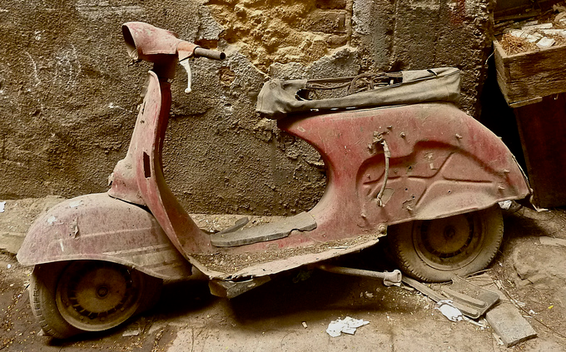
What do you wish your educators remembered about medical school?
“Its hard to find your way on your first day. I understand holding folks to high standards, but I needed a little more guidance and a little less public humiliation. I wish they had remembered how they felt the first time they were on a surgical service and that it’s like trying to merge into traffic moving at light speed while driving a moped.”
“Just because we are not going into surgery does not mean we are not interested in being involved and learning about it. I find surgery quite fun but feel like some residents don't let me be as involved when they hear I am not going into surgery.”
Notes:
L

Slide 27
What do you wish your educators remembered about medical school?
“Medical students are doing less with each passing year due to concerns over liability, etc. What you did in medical school, we aren’t able to do anymore. Of the medical students I know, less than half have ever placed an IV line by the end of 3rd year. Even now, cadaver lab has been removed and all that is left is textbooks and shelf exams. Any opportunity to learn a procedure, whether bedside or in the OR, is a skill gained that we will never have the chance to learn again before beginning residency. So try to get students involved.”
Notes:
L
And for this last quote, another student highlighted a significant challenge within medical education in the 21st century.

Slide 28

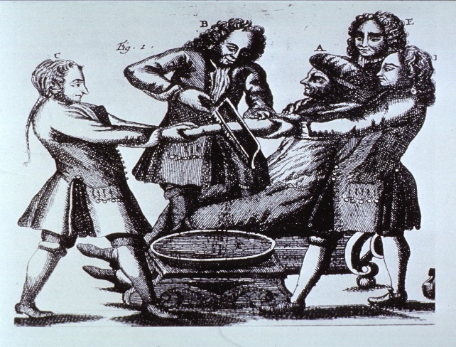
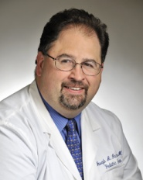
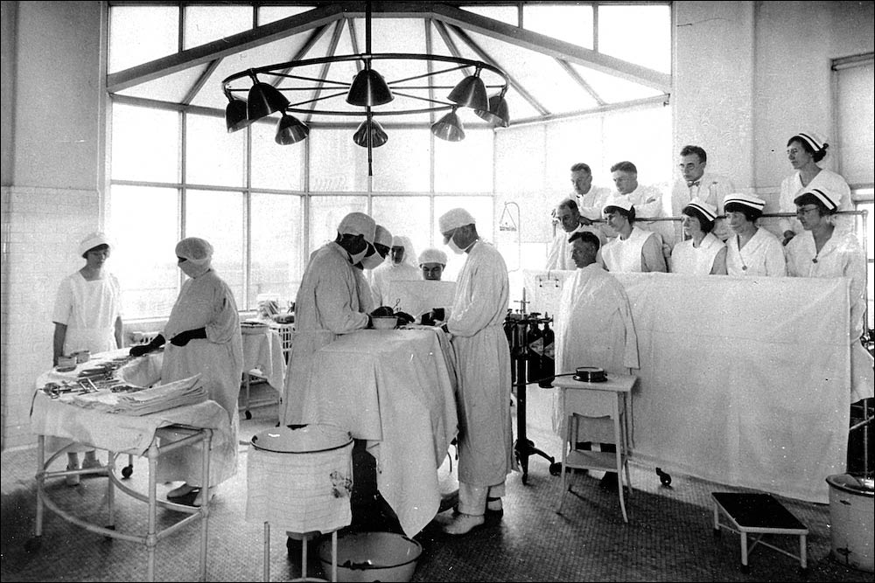

Bridging the Generational Gap
Notes:
Transition point, L → S
So how do we bridge this generational gap?
Blah blah, Lets talk about some of your generation’s preconceptions of the millennials and what we can do to get the most out of this clerkship.

Slide 29


Expectations & Feedback
We are used to instant feedback
Best compliment is silence…..doesn’t always work for us
Negative feedback ok as long as its not the ONLY feedback
Front end expectations more helpful than after-the-fact reviews
Orientation is key
Want to be involved; don’t know how
Not allowed to be involved yet on many levels
If students are there, they want to work/participate
Residents often don’t know what is expected of medical students
Notes:
Expectations and how our classmates respond to feedback.
In the age of internet reviews constant feedback forms, we really are used to getting and giving feedback
While some may think the best compliment is not being corrected, our generation generally responds to silence as a criticism.
We are more open to negative feedback than you give us credit for, if there is some constructive aspect to it.
Even more than feedback, the surveys showed that we really want clear guidelines of what we can and cannot do.
Feedback→ constructive criticism of some sort; this helps us feel as we are not being ignored. We welcome and respond positively to hard feedback that is given in an effort to educate, rather than an effort to isolate or demean.
In light of our increasing litigious society, we would benefit from early communication about how we are allowed to be involved and what our role on the team is. We like to know our boundaries as the “rule following generation”.
Fear of over stepping our bounds, not a lack of initiative, or laziness.
Safe example? Can’t write notes, consent, drains/dressing changes, morning list

Slide 30
“Shift Work” Mentality
Expect times to show up and go home
Correct this notion early
Give them a person in charge of them
Main concern is performance
Achieve expectations; move on to studying
Emphasis on standardized tests
Willing to sacrifice study time for patient care
Work-life balance: our way to avoid burnout?
Notes:
Stuck between. Need to budget
Many of these students have never had a full time job outside of school before. We are used to having a clear schedule of when to be where.
We need help getting out of this rigid schedule and into the expectation of “here is what needs to be done today, show up when you need to do be ready and leave we will go home when you are done.”
The main thing we get out of the rotation is our grade, largely based on our shelf, so many students want to get done what the need to at the hospital so they can go home and study for the shelf. Many students have the attitude that time on rounds is time taken away from studying.
New to us for third year in general, and this is especially exemplified on surgery when the time commitment is larger than most specialties!
Utilize your med student, might be pleasantly surprised

Slide 31
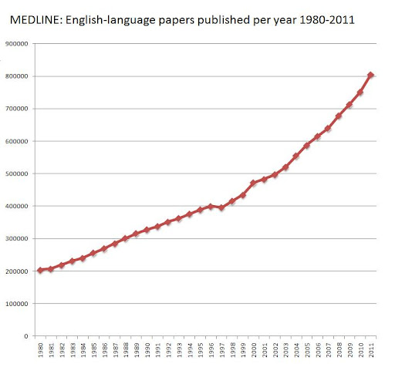
Spoon Fed
Pre-packaged information more efficient
Alternative methods of teaching are effective: videos in surgery
Resources relevant to your practice
Practice guidelines
Landmark studies
Efficiency in “bursts of learning”
Notes:
http://blogs.discovermagazine.com/neuroskeptic/2012/09/30/science-growing-too-fast/#.V985KJMrJE4
We are spoon fed by necessity. There is more and more information every year, it is necessary for students to find out how to condense this information into manageable bites.
They way that was most helpful to students during the surgery clerkship was for attending physicians and residents to give them resources relevant to their practice. There are more recourses than we can ever get through, what we need is to be told which ones are used in your field.
Good options for us other than studies are the videos or practice materials to learn how to do surgery.
Like we talked about with “shift work,” we have been trained to learn in 50 minute segments.
“They don’t want to break it up into the little bit sized pieces for us”
There is a lot of information to get lost in, there are good resources, relevant resources, and there are bad, misleading resources. Sorting through hours of material not specific to your practice (or you deem to be not the best, most current information) is a waste of time!

Slide 32


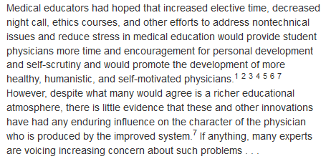
Final Thoughts
1986
Notes:
L

Slide 33
Final Thoughts
Every generation sees itself as better and harder working than the one before
Dubovsky “Coping with Entitlement in Medical Education” 1986
We bring positives to the table
Is more of a focus on work/life balance a bad thing?
Feedback early and often shown to be a very effective method of teaching and learning
Don’t confuse laziness and lack of motivation with not having had adequate instruction!
Notes:
The OR is not an intuitive or natural environment and it takes some time to get used to the language, protocols and expectations. We have no experience that lets us anticipate what will happen next or what is needed from us.
We don’t know how to get involved

Slide 34

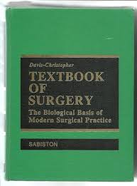
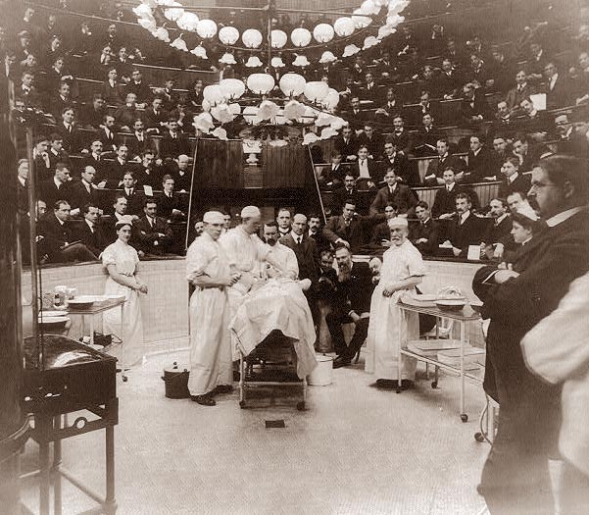

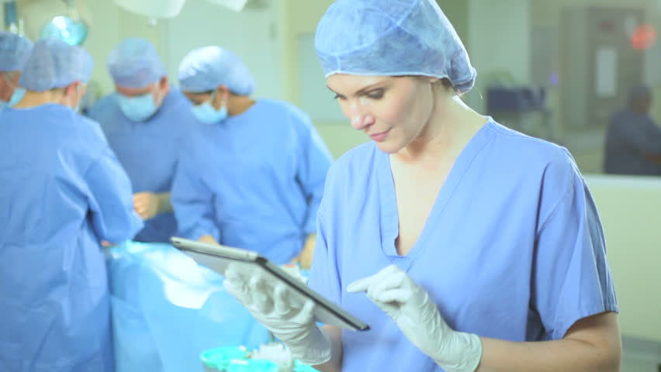
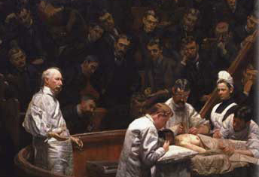
Final Thoughts
Can we meet in the middle?

Slide 35
Conclusion
Student clerkship in Surgery
Education first
Immerse in field, hands on learning
USE us as resource, not impediment to care
Engage our enthusiasm, set bar high
Remember that it is ALL new, and if we fail once, don’t discourage
Trust that we are there to care as much as learn
Notes:
S
Most people aren’t going into surgery, this is our chance to learn how to do surgery
Need to do well on shelf

Slide 36
References
Bradley et al; The surgical clerkship: a contemporary paradigm. J of Surgical Research. 117:14- 20 (2012).
Dubovsky, SL. Coping with Entitlement in Medical Education. N Engl J Med. 315:1672-4(1986).
Goldin, SB; et al; Perspectives of Third-Year Medical Students Toward Their Surgical Clerkship and a Surgical Career. J of Surgical Research. 142:7–12 (2007).
Lipman, et al. Defining Honors in the Surgery Clerkship. J Am Coll Surg. July 2016. 1-5.
Phillips, et al; Training the millennial generation: Understanding the new generation of learners entering colon and rectal residency. Seminars in Colon and Rectal Surgery.
26:147–149 (2015).
Schmidt et al; Factors influencing US medical students’ decision to pursue surgery. Journal of Surgical Research, 203:64-74 (2016).
Stone et al; Under the Knife: Medical Student Perceptions of Intimidation and Mistreatment. J of Surgical Education. 72:749-753 (2015).
Zundel1 et al; The surgical experience of current non-surgeons gained at medical school: a survey analysis with implications for teaching today’s students. BMC Medical Education 15:187(2015).

