Slide 1
Medical Retina Fellowship

Slide 2
Medical Retina Fellowship
Strong clinical training
Retinal diseases
Uveitis
Inherited Retinal disorders
Research – encouraged and fostered

Slide 3
Faculty
Dr. Michelle Abou-Jaoude, MD (Program Director)
Dr. Andrew Pearson (Dept. Chair)
Dr. Ana Bastos (Medical Retina)
Dr. Claire Fraser (VR retina)
Dr. Peter Blackburn (VR retina)
Dr. Aditya Bansal (VR Retina)

Slide 4
Schedule
Monday | Tuesday | Wednesday | Thursday | Friday
Retina Clinic | Retina Clinic |  | Retina Clinic | Retina Clinic
 |  | Research Day*
*Floats each week depending on scheduling and replaces clinic responsibilities that day*

Slide 5
Academic Activities
Fellow’s Conference 2nd Tuesdays; 7-8am
Fluorescein Angiography Conf Friday; 7-8am
Grand Rounds Friday; 8-9am
Other:
Journal Clubs
Research team meetings
Resident Didactics

Slide 6
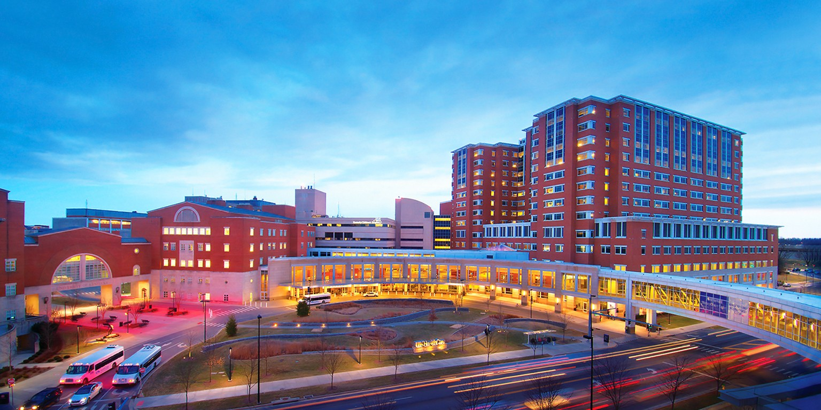
Facilities – UK Medical Campus

Slide 7
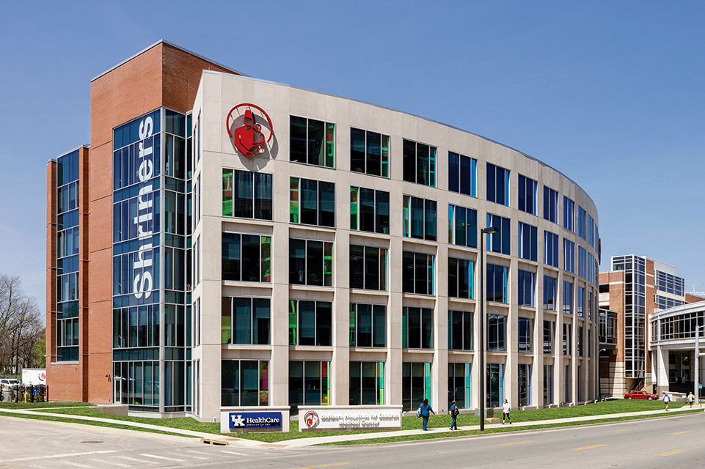
Facilities
Eye Center – UK Campus
Community Clinics:
Georgetown
Richmond
Satellite Clinics:
London
Somerset
Corbin
Harlan
Campbellsville
Hazard

Slide 8
Clinics - Equipment
Imaging Suite
OCT: Heidelberg Spectralis (2)
OCTA: Zeiss Elite Plex Swept source – wide field
Optos color & FAF
Optos FA and ICG
Topton fundus Camera
B-scan
Anterior segment UBM

Slide 9
Clinics - Equipment
Other
Pascal laser
Indirect Ophthalmoscope Laser
PDT laser
Dedicated injection rooms

Slide 10
Clinics – Specialized testing
Specialized testing
Electroretinogram
Multifocal ERG
Portable ERG
Dark Adaptometry
Visual fields (Goldman and Humphrey)
Microperimetry

Slide 11
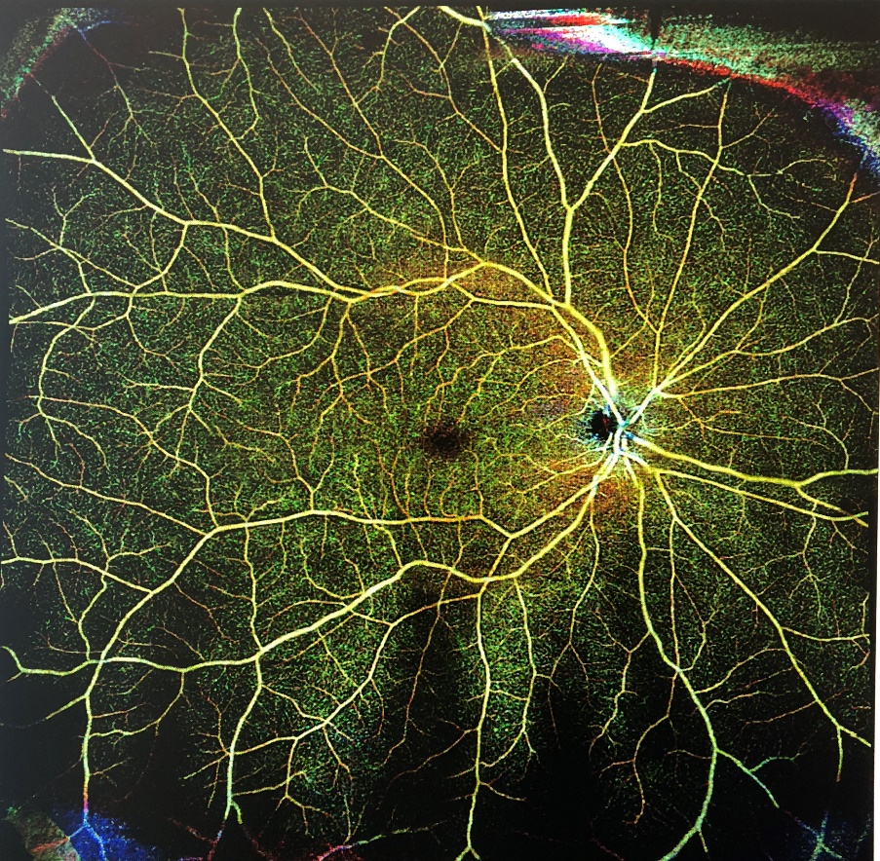
Research
Multiple areas
Ophthalmic Genetics
Retinal Imaging
Uveitis
Retinal disorders

Slide 12
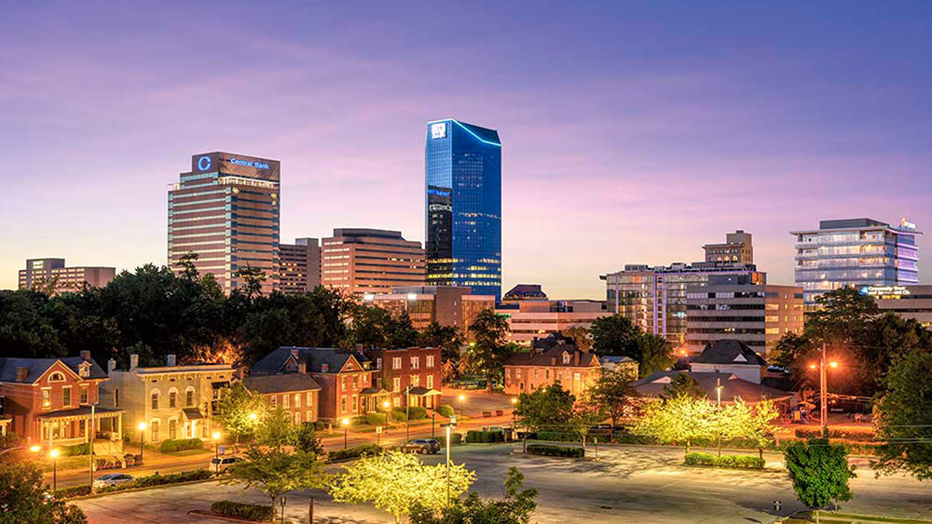
Lexington

Slide 13
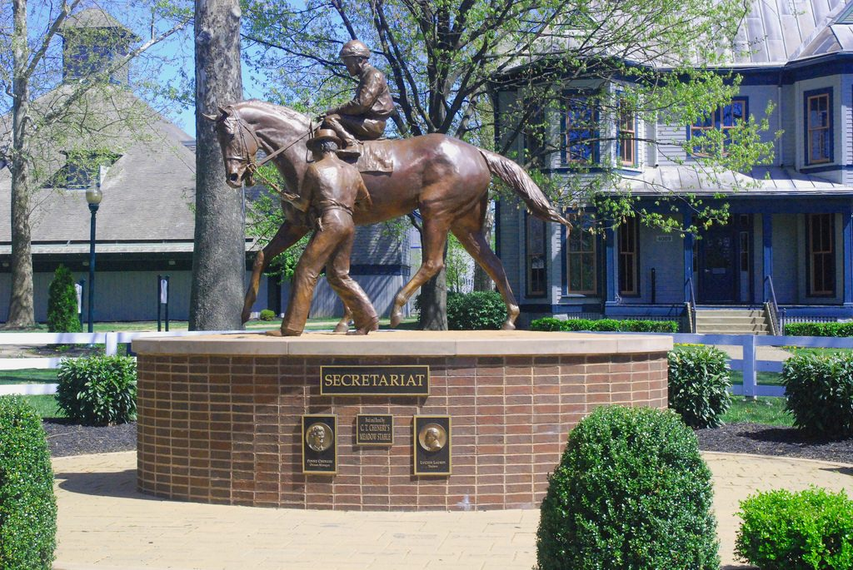
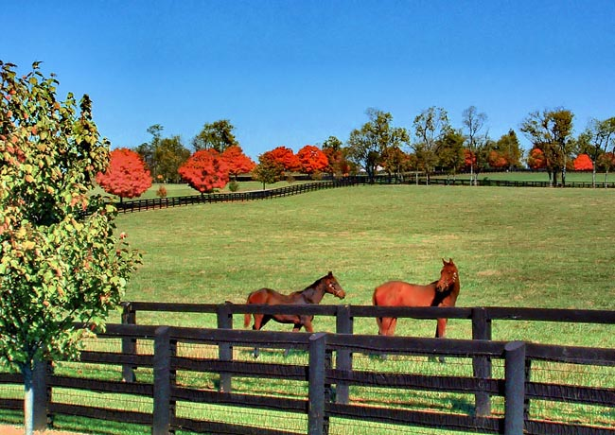
Outdoors

Slide 14
Thank you for your interest in our program.
Good luck on your interview.
If you have any questions, please contact:
Fellowship Coordinator, Shelby Lynn
Shelby.Lynn@uky.edu
Program Director, Michelle Abou-Jaoude, M.D.
michelle.abou-jaoude@uky.edu

