Slide 1
Kentucky Social Welfare Foundation ATTN: Administrative Assistant P.O. Box 1288 Union, Kentucky 41091 kswf.org grants@kswf.org Anne Eason, LCSW Chairperson, KSWF

Slide 2
Who are we???
Charitable Foundation, Founded in 1948
Endowed by Martha Davis – Kentucky Social Worker
Governed by Board of Trustees - social workers and other interested citizens of Kentucky
Distribute grants to non-profit organizations in Kentucky
2 grant cycles/year

Slide 3
Our Mission
Purpose:
The purpose of the Kentucky Social Welfare Foundation is to improve quality of life and opportunity among Kentuckians who experience diminished economic opportunities, whether due to poverty, poor health, disability, or inequality.
Targeting our grants to rural areas, small towns, and geographic areas of special need, KSWF seeks to promote efficient and effective social welfare organizations and methods for providing “self-help and training.”
KSWF fulfills this purpose through monetary grants to established non-profit organizations that will:
“enlarge and broaden their scope of operation”
and/or
develop and implement “new projects to provide services which no agency, already in operation, is planned or equipped to extend.”

Slide 4
Grant sizes?
KSWF awards grants to non-profit organizations working to support and improve the lives of Kentuckians across the state. In the last five years, KSWF grant awards have ranged from $1,000 to $34,121.
Our average grant award is $10,833.35.
Since 1991, KSWF has given out grants totaling 3,444,166 in 393 total grants

Slide 5
What is important for a successful grant application? Dr. Susan Wesley, PhD

Slide 6
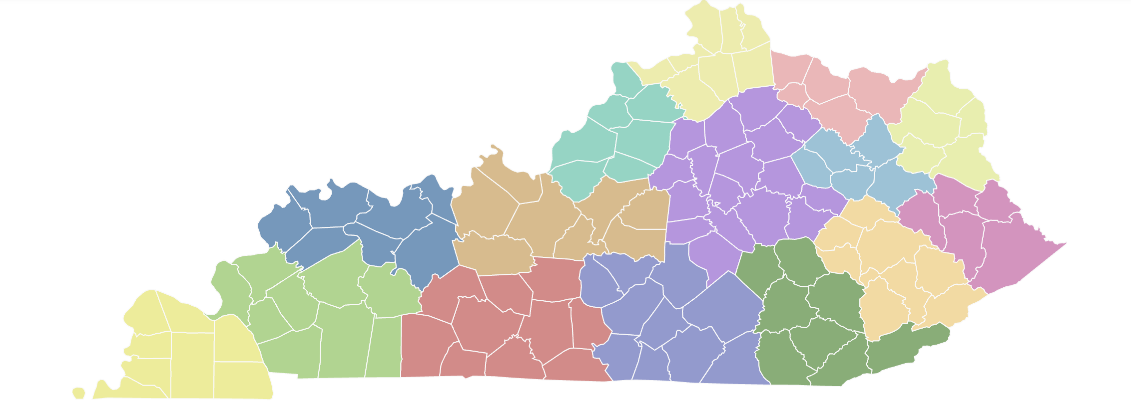
Kswf.org: Our Interactive Map Karisa Moore, Administrative Assistant

Slide 7
How to Apply
Kswf.org
Complete screening questions
If eligible, advance to application
Important documents:
501(c)(3) IRS determination letter
Agency budget
Project budget (be specific)

Slide 8
Deadlines
2 grant cycles annually
Next deadline: March 24, 2023

Slide 9
Questions???

Slide 10
Contact Information
Kentucky Social Welfare Foundation ATTN: Administrative Assistant P.O. Box 1288 Union, Kentucky 41091 kswf.org
grants@kswf.org

