Slide 1
Office of Health Equity Vivian Lasley-Bibbs, Director
Sue M. Higgins, MPH
December 6, 2022

Slide 3
Kentucky Office of Health Equity (OHE)
Mission
Promote the understanding of the root causes of health disparities and promote health equity among racial, ethnic, rural, and low-income populations in Kentucky.
Health equity is achieved when all individuals can attain their full health potential, access to health information, and achieve balanced healthcare access of information across the Commonwealth.

Slide 4
OHE Funding
Centers for Disease Control and Prevention grant:
National Initiative to Address COVID-19 Health Disparities Among Populations at High-Risk and Underserved, Including Racial and Ethnic Minority Populations and Rural Communities (Award number: 1 NH750T000040)
Funding cycle:
June 1, 2021 – May 31, 2023
No Cost Extension until May 31, 2024

Slide 5
Interested Vendors
Must be registered:
At the Vendor Self Service portal:
https://emars311.ky.gov/webapp/vssprdonline3111d/AltSelfService
Also with the Secretary of State at: https://onestop.ky.gov/Pages/default.aspx

Slide 6
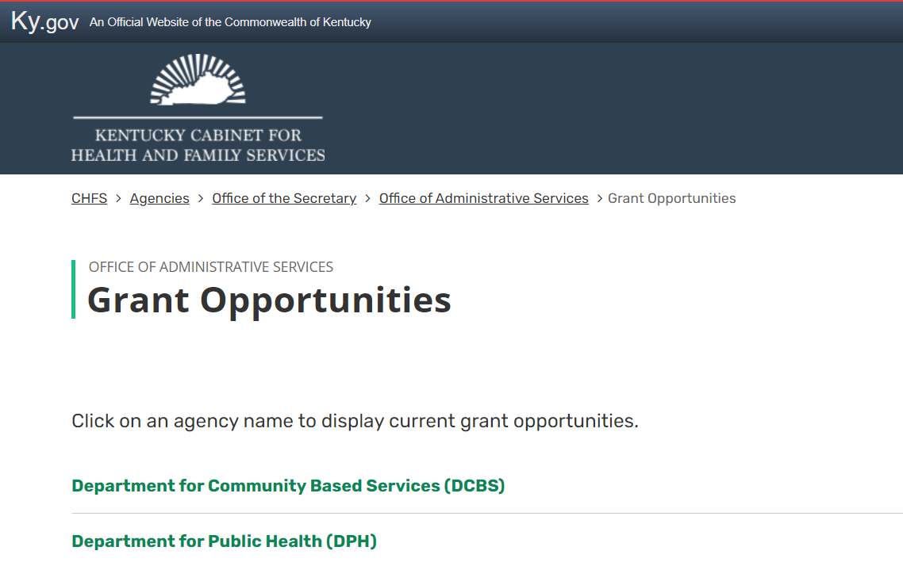
Kentucky Cabinet for Health and Family Services
Visit: https://chfs.ky.gov/agencies/os/oas/Pages/grants.aspx
Click on Department for Public Health hyperlink
Click on: “Promoting Health Equity in Underserved Populations Across the Commonwealth of Kentucky”

Slide 7
Eligible Entities for the Request for Applications (RFA)
Who can apply:
501c3 non-profit organizations
Quasi-governmental organizations
Government entities

Slide 8
OHE Request for Applications
Intent is to support:
Existing and new community partners who serve high-risk and underserved populations
Formalize collaboration among partners
Expand existing operations
Create new operations
Projects that help, build, leverage, and expand capacity

Slide 9
Four Components of the Proposal
Cover letter
Response to the eight questions
Budget template
Workplan
* Page Six of the RFA

Slide 10
Responses to the RFA Questions
Brief history of the organization
Identify population(s) being served
Geographic area(s)
Method or process to capture client engagement and feedback
Measurable outcomes
Explain how health promotion/education will be provided, if/how existing services will be expanded, or capacity building
Program plan and what you hope to achieve
Sustainability plan
* Page Seven of the RFA

Slide 11
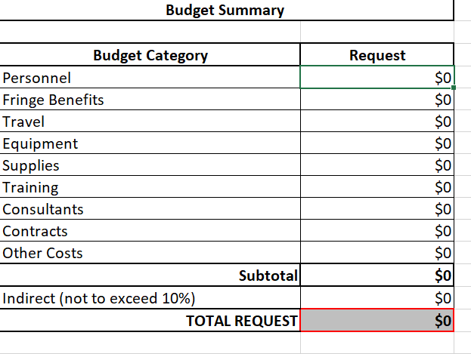
DPH Budget Template
Complete each tab of the template that is applicable to the proposed project.
NOTE: Do not delete the formulas embedded in certain cells.
* Page Eight of the RFA

Slide 12
Budget: Allowable and Not Allowable Costs
Allowable Costs:
Personnel
Fringe benefits
Travel (at state rate)
Equipment
Office supplies
Training
Consultants
Contracts
Not allowable costs:
Food
Office furniture
Building repair or enhancement
Laptop/I-Pad/computers
* Page Six of the RFA

Slide 13
Workplan
* Page Eleven of the RFA

Slide 14
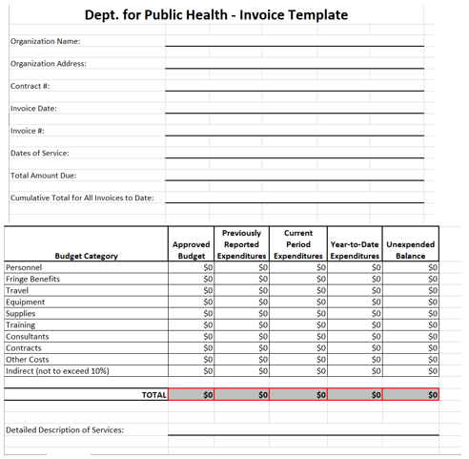
Invoice Template
Invoice should be completed (either monthly or quarterly) and submitted to:
CHFSPayablesBranch@ky.gov

Slide 15
DPH Approval process
Once a proposal is approved by OHE, it is then routed for approval through the Department for Public Health and the Cabinet.
Approval process may take up to eight weeks
Vendor will be contacted for e-signature
*** Services can NOT begin until the vendor receives final notification from Division Procurement and Grant Oversight (DPGO)***

Slide 16
Office of Health Equity Staff
Vivian Lasley-Bibbs
Teresa Davis
Mary Nichols
CDC Foundation
Nicole Weiss
CDR Maguire
Sue Higgins
Johan Malcom
Brandi Newhouse

Slide 17
Address Questions
DPHGrantsCoordination@ky.gov

